Slide 1


NTA and UNFPA Implementation
How do we work to get policy attention?
United Nations Population Fund
Wassana Im-em, UNFPA Asia-Pacific Office
14 February, 2023
The 14th NTA Global Conference in Paris

Slide 2

Outline
UNFPA and NTA work in Asia-Pacific – over a decade of collaboration with NTA network
What have we delivered on NTA – achievements, challenges, and opportunities
Communication to policy planners with evidence
  The demographic dividends atlas for Asia-Pacific region based on the NTA analysis of 26 countries
  Policy briefs and communication materials
Our future plan for 2023-2025
Policy considerations

Slide 3
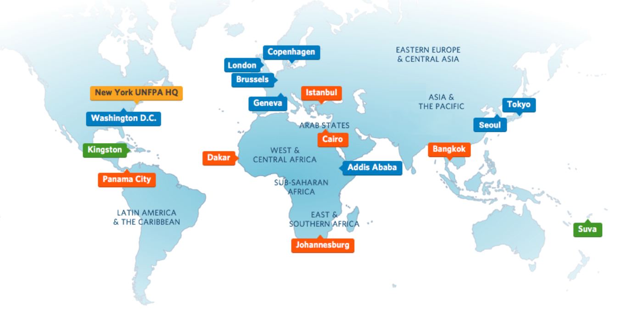
UNFPA Operations Worldwide
Our mission is to deliver a world where every pregnancy is wanted, every childbirth is safe and every young person's potential is fulfilled.
UNFPA has 120 offices that serve 156 countries, territories and areas worldwide.
In Asia-Pacific region, our regional office is based in Bangkok, Thailand providing technical and programme support to 22 country offices and a sub-regional office in Suva, Fiji.

Slide 4
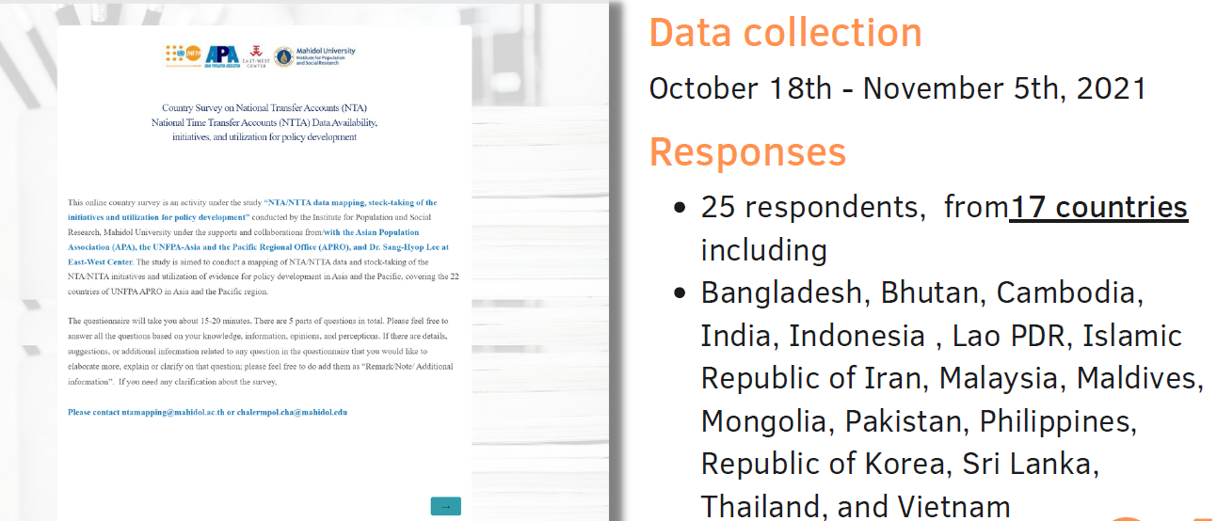
Mapping of NTA/NTTA data and initiatives in Asia-Pacific
Source: Chalermpol Chamchan (2021), NTA informant survey in Asia-Pacific, supported by UNFPA APRO

Slide 5
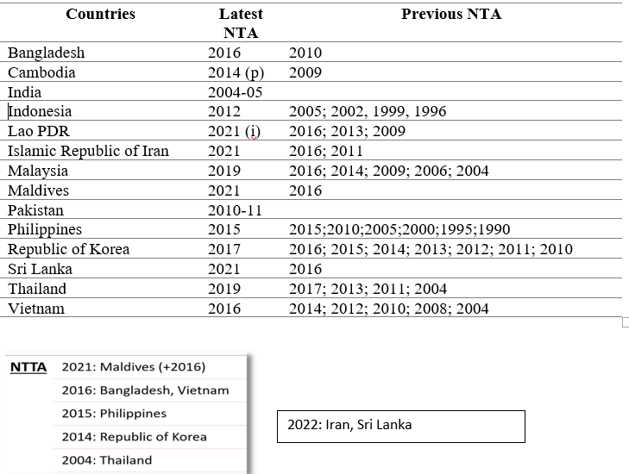
Mapping of NTA/NTTA estimates in the Asia-Pacific Countries
Demographic Dividend Atlas using NTA analysis by UNFPA APRO covers 26 countries in the region
2011-12
China: 2010,2014, 2018
No NTA work at country level yet
Bhutan
Nepal
Myanmar
Papau New Guinea
The Pacific
On-going - Mongolia
Not all NTA/NTTA estimates by countries were engaged by UNFPA.
Various approaches were adopted by UNFPA Country Offices on our engagements
Source: Chalermpol Chamchan (2021), NTA informant survey in Asia-Pacific, supported by UNFPA APRO
Notes:
The survey data was obtained in 2021 collected from the informants from the NTA network in the region provided by Prof. Lee together with UNFPA Country offices. Yet, not all UNFPA country offices have been active on the NTA estimates by the experts.

Slide 6
What do we do on NTA/NTTA by UNFPA Offices in Asia-Pacific
Overall
Capacity development/training
Advocacy for policy attention
Communication to policy planners
UNFPA Country Offices
Different approaches adopted among country offices
  Limited engagement – no capacity vs no interest
  Support productions of NTA/NTTA estimates – consultant/university experts vs government agencies
  High level engagement attempting to institutionize NTA know-how and utilizing the findings to support policies
Asia-Pacific Regional Office
Support high-level advocacy with country offices bringing in relevant line ministries
Provide capacity development and advocacy platforms
Promote a better balance on demand and supply on NTA/NTTA estimates for policy attention
Convene networking, information sharing, and lessons learned across all levels
Review and package NTA key messages to produce simple communication materials for policy planners
Engage with other UN agencies – DESA, ESCAP, ILO

Slide 7
Constraints
Limited understanding, awareness, and buy-in on importance and potential usage of NTA/NTTA findings for policy attention
Better communication between NTA practitioners & policy planners needed
Frequent changes of the government/policy planners who can link NTA to policy
Unavailability of data

Slide 8
Our work on NTA/NTTA by UNFPA APRO, 2010-2022
Implement the SAMANTA Project - Strengthening, Accelerating, and MAinstreaming NTA
for policy advancement in Asia-Pacific
Capacity Development
2002: A project on NTA in Thailand by UNFPA HQ and IDRC
2010: 1st regional training, Hua Hin
2014: 2nd regional training, Pattaya
2015: 3rd regional training, Bangkok
2016: Two sub-regional trainings in Kathmandu and in Kuala Lumpur
2017: 4th regional training, Chiang Mai
2022: 5th regional training, Bangkok
2024-25: 6th regional training
Advocacy Efforts
2021 onwards: Implementing the SAMANTA Project
2021-22: Mapping data and initiatives on NTA among countries in Asia-Pacific
2021-22: Proceedings of meeting/conferences on NTA
2021-22: The Demographic Dividend Atlas for 22 countries in Asia and 4 countries in the Pacific.
Advocacy Platforms
2021: NTA regional hybrid conference held in Yogyarkata
2022: Side meeting on ‘Silver Economy and NTA’, the 5th MIPPA review by ESCAP
2022-3: Review on utilizing NTA to support policy attention
2023: Review and package communication materials on NTA for policy planners
2023: Reference group on NTA and population ageing
Missing piece – how to build story telling on NTA eg. Future lab on population ageing?

